Slide 1
Economic Overview of Sauk County
Matt Kures
Center for Community & Economic Development
University of Wisconsin-Extension
January 29, 2015

Slide 2
Using Economic and Demographic Data
Uses:
Stimulate discussion;
Affirm or challenge current perceptions;
Identify local strengths and weaknesses;
Recognize and prepare for change.
Considerations:
Looking for patterns, not a single answer;
More concerned with trends than precision;
Focus more attention on comparing figures rather than ranking them.

Slide 3
An Emphasis on Economic Assets How many of these are available in or influenced by a single community?
Human Capital - Knowledge and skills of the labor force, community residents, and local institutions;
Research and Educational Institutions – Create innovation and develop human capital;
Natural Capital – Assets that are inherent to geographic location such as weather, natural resources, and amenities;
Industry Clusters and Concentrations - Industries that form the basis for regional competitiveness;
Infrastructure – Highways, broadband, airports, etc.;
Social Capital – Networks and connections among people and organizations;
Quality of Life – Definition of QoL varies, but is an important factor driving where people and enterprises decide to locate;
Others – Financial capital, political capital; regulatory environment, etc.
Partially adapted from Flora and Emery (2006)
Notes:
Do what you can, with what you have, where you are.

Slide 4
Data Source: Bureau of Economic Analysis

Slide 5
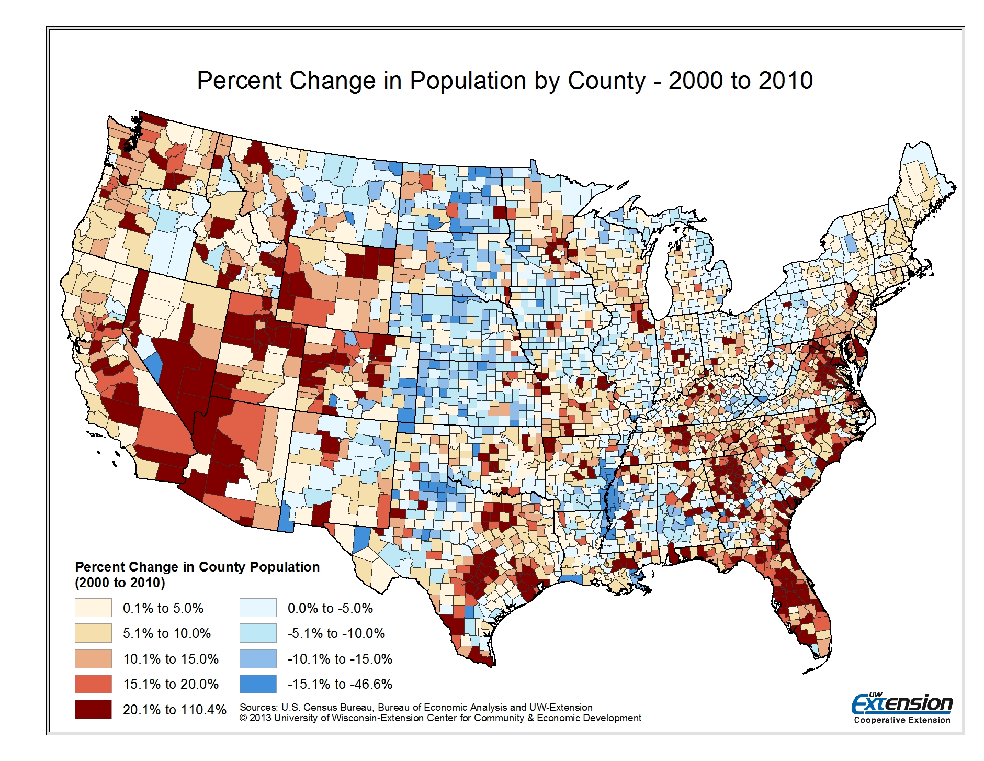

Slide 6
Data Source: Wisconsin Department of Administration Demographic Services Center

Slide 8
Source: Age-Specific Net Migration Estimates for US Counties, 1950-2010. Applied Population Laboratory, UW-Madison, 2013

Slide 9
Worker Flow for Sauk County
Employees Working in Sauk County
County of Residence (n = 29,325)
Employees Residing in Sauk County
County of Employment (n= 29,055)
Place of Residence | Count | Share
Sauk County, WI | 14,756 | 50.3%
Dane County, WI | 2,825 | 9.6%
Columbia County, WI | 1,825 | 6.2%
Juneau County, WI | 1,184 | 4.0%
Richland County, WI | 999 | 3.4%
Adams County, WI | 671 | 2.3%
Iowa County, WI | 625 | 2.1%
Monroe County, WI | 415 | 1.4%
Grant County, WI | 373 | 1.3%
Vernon County, WI | 362 | 1.2%
All Other Locations | 5,290 | 18.0%
Place of Employment | Count | Share
Sauk County, WI | 14,756 | 50.8%
Dane County, WI | 5,705 | 19.6%
Columbia County, WI | 2,870 | 9.9%
Milwaukee County, WI | 1,005 | 3.5%
Waukesha County, WI | 831 | 2.9%
Iowa County, WI | 557 | 1.9%
Richland County, WI | 358 | 1.2%
Fond du Lac County, WI | 314 | 1.1%
Rock County, WI | 302 | 1.0%
Juneau County, WI | 296 | 1.0%
All Other Locations | 2,061 | 7.1%
Data Source: U.S. Census Bureau OnTheMap LODES Data

Slide 10
Worker Flow for the City of Reedsburg – 2011
Employees Working in the City of Reedsburg (n = 5,460) – Place of Residence
Employees Residing in the City of Reedsburg (n= 4,756) - Place of Employment
Place of Residence | Count | Share
City of Reedsburg | 1,620 | 29.7%
City of Baraboo | 185 | 3.4%
Town of Reedsburg | 170 | 3.1%
Town of La Valle | 149 | 2.7%
Town of Excelsior | 143 | 2.6%
Town of Dellona | 132 | 2.4%
Town of Winfield | 111 | 2.0%
Town of Woodland | 97 | 1.8%
City of Madison | 75 | 1.4%
Town of Ironton | 67 | 1.2%
All Other Locations | 2,711 | 49.7%
Place of Employment | Count | Share
City of Reedsburg | 1,620 | 34.1%
City of Baraboo | 540 | 11.4%
City of Madison | 355 | 7.5%
City of Wisconsin Dells | 282 | 5.9%
Town of Reedsburg | 251 | 5.3%
Village of Lake Delton | 179 | 3.8%
City of Dodgeville | 105 | 2.2%
City of Milwaukee | 103 | 2.2%
Town of Delton | 58 | 1.2%
Town of La Valle | 36 | 0.8%
All Other Locations | 1,227 | 25.8%
Data Source: U.S. Census Bureau OnTheMap LODES Data

Slide 11
Worker Flow for Sauk City and Prairie du Sac
Employees Working in Sauk City/Prairie du Sac
(n = 4,362) – Place of Residence
Employees Residing in Sauk City/Prairie du Sac
(n= 4,337) - Place of Employment
Place of Residence | Count | Share
Village of Prairie du Sac | 616 | 14.1%
Village of Sauk City | 589 | 13.5%
City of Baraboo | 164 | 3.8%
City of Madison | 142 | 3.3%
Town of Prairie du Sac | 140 | 3.2%
Town of Roxbury | 116 | 2.7%
City of Lodi | 112 | 2.6%
Town of Honey Creek | 104 | 2.4%
Town of Cross Plains | 84 | 1.9%
Town of Sumpter | 78 | 1.8%
All Other Locations | 2,217 | 50.8%
Place of Employment | Count | Share
City of Madison | 953 | 22.0%
Village of Sauk City | 624 | 14.4%
Village of Prairie du Sac | 581 | 13.4%
Town of Prairie du Sac | 247 | 5.7%
City of Baraboo | 205 | 4.7%
City of Middleton | 200 | 4.6%
City of Milwaukee | 100 | 2.3%
Village of Waunakee | 77 | 1.8%
City of Lodi | 58 | 1.3%
City of Wisconsin Dells | 42 | 1.0%
All Other Locations | 1,250 | 28.8%
Data Source: U.S. Census Bureau OnTheMap LODES Data

Slide 12
Age Distribution – 2010 Census
Age Group | Sauk County | State of Wisconsin | United States
Age 25 to 54 | 40.9% | 40.9% | 41.2%
Age 15 to 64 | 65.4% | 67.0% | 67.1%
Total Population | 61,976 | 5,686,986 | 308,745,538
Under 5 | 6.4% | 6.3% | 6.5%
5 to 14 | 13.2% | 13.1% | 13.3%
15 to 24 | 11.7% | 13.8% | 14.1%
25 to 34 | 12.5% | 12.7% | 13.3%
35 to 44 | 13.0% | 12.8% | 13.3%
45 to 54 | 15.4% | 15.4% | 14.6%
55 to 64 | 12.8% | 12.3% | 11.8%
65 to 74 | 7.7% | 7.0% | 7.0%
75 to 84 | 4.8% | 4.5% | 4.2%
85 or More | 2.5% | 2.1% | 1.8%
Data Source: U.S. Census Bureau, 2010 Summary File 1

Slide 13
Sauk County Age Distribution Comparison – 2010 Census to 2030 Projection
Age Group | Sauk County 2010 | Sauk County 2030
Age 25 to 54 | 40.9% | 36.7%
Age 15 to 64 | 65.4% | 58.8%
Total Population | 61,976 | 75,660
Under 5 | 6.4% | 5.9%
5 to 14 | 13.2% | 12.5%
15 to 24 | 11.7% | 10.6%
25 to 34 | 12.5% | 11.1%
35 to 44 | 13.0% | 12.8%
45 to 54 | 15.4% | 12.8%
55 to 64 | 12.8% | 11.5%
65 to 74 | 7.7% | 12.1%
75 to 84 | 4.8% | 7.9%
85 or More | 2.5% | 2.8%
15.0% =
22.8% =
Data Source: U.S. Census Bureau and Wisconsin Department of Administration

Slide 14
Data Source: Wisconsin Department of Administration Demographic Services Center

Slide 16
Data Source: U.S. Census Bureau LED

Slide 17
Data Source: U.S. Census Bureau LED

Slide 18
Data Source: U.S. Census Bureau LED

Slide 19
Building Partnerships among Workforce Development Organizations and Stakeholders
ED professionals need to develop partnerships with the network of WD organizations and understand their respective roles;
Economic development professionals have an opportunity to serve as intermediaries and entry points to the WD system;
Need leadership, a shared vision, flexibility and common metrics;
Partners are likely regional – labor force and firms do not adhere to administrative boundaries;
Examples of WD Organizations and Stakeholders
Community Colleges and Technical Schools
K-12 System
Universities
Community and Faith-Based Organizations
Social Service Agencies
Economic Development and Workforce Development Organizations
Employers
Labor Organizations

Slide 20
Data Source: Bureau of Economic Analysis

Slide 21
Data Source: National Establishment Time Series Database extracted from YourEconomy.org

Slide 22
Data Source: National Establishment Time Series Database extracted from YourEconomy.org

Slide 23
Business Stages
Self-Employed (1 employee) - Small-scale business activity that can be conducted in homes as well as sole proprietorships;
Stage 1 (2-9 employees) – Includes partnerships, lifestyle businesses and startups. Often focused on defining a market, developing a product or service, obtaining capital and finding customers;
Stage 2 (10-99 employees) – A company typically has a proven product, and survival is less of a daily concern. Companies begin to develop infrastructure and standardize operational systems. Leaders delegate more and wear fewer hats;
Stage 3 (100-499 employees) - Expansion is a hallmark as companies broaden their geographic reach, add new products and pursue new markets. Stage 3 companies introduce formal processes and procedures, and the founder is less involved in daily operations and more concerned with managing culture and change;
Stage 4 (500 or more employees) – By Stage 4, an organization is typically dominant in its industry and is focused on maintaining and defending its market position. Key objectives focus on tasks such as controlling expenses, raising productivity, increasing market penetration and managing market niches.
Source: Edward Lowe Foundation/YourEconomy.org

Slide 24
Data Source: National Establishment Time Series Database extracted from YourEconomy.org

Slide 25
Data Source: National Establishment Time Series Database extracted from YourEconomy.org

Slide 26
Data Source: National Establishment Time Series Database extracted from YourEconomy.org

Slide 27
Traditional and New Models of Economic Development
Traditional Model
New Model
Industrial Recruitment
Attraction
Expansion
Small Business
Startups
Retention
Entrepreneurship
Source: Dabson (2003)

Slide 28
Types of Entrepreneurs
Survival Entrepreneurs
Subsistence income goals;
Related to professional skill/knowledge;
Tied to location not market opportunity.
Lifestyle Entrepreneurs
Sacrifice business success for personal lifestyle choices;
Typically service sector enterprises;
Tied to location not market opportunity;
Often successful, but limited growth and employment.
High Growth Entrepreneurs
Profit and growth driven;
Priority placed on maximizing market opportunities;
Aggressively seeks our resources to fuel growth;
Creates jobs, wealth, tax base and reinvests in community.
Intrapreneurs
Spin-offs of existing firms to address new market opportunity.

Slide 29
Economic Development Organizations as Part of an Entrepreneurial Development System (EDS)
EDOs have many important roles in an entrepreneurial development system:
Help develop the entrepreneurial infrastructure – Broadband, physical locations, business service development (insurance, banking, real estate, etc.);
Identify current entrepreneurs in the region – Serve as a conduit to other service providers;
Workforce development;
EDOs can provide feedback on the effectiveness of entrepreneurial programs in the region;
Develop a “pipeline” of future entrepreneurs – provide entrepreneurial education, recognition, and outreach programs;
Provide potential support for specialized programs targeting a subset of entrepreneurs (e.g. Economic Gardening TM, Scale Up, etc.);
Source: Macke et al (2014), Center for Rural Entrepreneurship

Slide 31
Thinking about Niches or Specializations - Industry Categories with Highest Location Quotients in Sauk County
NAICS and Industry Description | Sauk County Employment | Sauk County Location Quotient | South Central WI Location Quotient
326 Plastics & Rubber Product Mfg. | 1,187 | 6.91 | 2.35
331 Primary Metal Mfg. | 737 | 6.89 | 1.46
721 Accommodations | 2,535 | 6.69 | 1.10
327 Non-metal Mineral Product Mfg. | 664 | 6.50 | 1.16
323 Printing & Related Services | 721 | 4.94 | 2.63
112 Livestock | 1,318 | 4.75 | 1.94
442 Furniture & Home Furnishings | 453 | 3.36 | 1.01
332 Fabricated Metal Product Mfg. | 1,220 | 3.27 | 1.73
113 Forestry & Logging | 96 | 3.08 | 0.29
454 Non-store Retailers | 1,215 | 2.82 | 2.49
713 Amusement, Gambling and Recreation | 1,357 | 2.63 | 1.01
115 Agriculture and Forestry Services | 405 | 2.42 | 0.84

Slide 33
Sauk County as a Part of Regional Supply Chains
Dairy products – Cheese, fluid milk, butter, and dry, condensed & evaporated
Computer Design and Programming Services
Legal, Accounting and Financial Services
Sweeteners, flavorings, syrups and starches
Animal Food Manufacturing
Grain and Oilseed Milling
Engineering and Design Services
Unprocessed, processed and rendered animal products from cattle, poultry, pork and seafood
Sugar and Confectionery Product
Dairy Product Manufacturing
Industrial Machinery Leasing and Repair
Industrial Process Instruments
Seasonings and dressings
Other Food Manufacturing
Animal Slaughtering and Processing
Plastic and Stainless Steel Fixtures, Repair & Service
Oilseed products – Soy, oils, shortening and margarine
Seafood Product Preparation and Packaging
Bakeries and Tortilla Manufacturing
Soaps, Cleaning Compounds and Lubricants
Flour, malt and grains
Wholesale
Vegetables and fruits – fresh and preserved
Fruit and Vegetable Preserving &
Specialty Food Manufacturing
Plastic, Metal, Glass and Paperboard Packaging
Nuts
Transportation Services
Eggs
Printing

Slide 34
Data Source: Bureau of Economic Analysis

Slide 35
Data Source: Bureau of Economic Analysis

Slide 36
Examples of Regional Economic Development Activities
Targeted Industry Development
Government Affairs
Marketing/Information Dissemination
Supply Chain Development
Export Assistance
Infrastructure Development
Workforce Development
Entrepreneurial Development
Networking/Social Capital Development

Slide 37
For More Information on Today’s Presentation
Matt Kures
University of Wisconsin-Extension
Center for Community & Economic Development
cced.ces.uwex.edu
twitter.com/uwexcced
610 Langdon Street, Room 328, Madison, WI 53703
Phone 608-265-8258 matthew.kures@ces.uwex.edu

