Slide 1
The Recovery from the Great Recession
In this presentation
  National forecasts are produced by Global Insight, Inc.
  State and Metropolitan forecasts are public information produced by the Division of Research and Policy, Wisconsin DOR.
  Information is supplied by the U.S. Bureau Of the Census, U.S. Bureau of Labor Statistics, U.S. Bureau of Economic Analysis, Federal Housing Finance Authority, Federal Reserve Board of Governors, Federal Reserve Bank of Philadelphia, Federal Reserve Bank of New York, the Wisconsin Department of Workforce Development, and various divisions of the Wisconsin DOR.

Slide 2
Today’s Themes
Living a Half-Fast Recovery.
Paying the Stimulus Bill
Monetary Policy Paradox
Prospects for US and Wisconsin in 2011 & 2012
Prospects for the Baraboo Micropolitan Area Economy

Slide 3
Economy Now Fully Recovered
At least pending another GDP Revision

Slide 4
Recovery Already in 34th Month

Slide 5
Real GDP Growth Has Stalled Compared to Recent Recoveries

Slide 6
Growth is About Half of Post War Average
Recoveries Aren't What They Used to Be

Slide 7
For Those Who Took Economics and Managed to Stay Awake
Remember the National Income Identity
Yd = C + I + (X-M) + G
Total Aggregate Demand is the sum of purchases for consumption, investment, net exports and government.

Slide 8
Consumption Fully Recovered by Late 2010

Slide 9
US Retail Sales Up 6.5% on the Year

Slide 10
Exports Recovered Quickly

Slide 11
Wisconsin Exports Set a Record in 2011
But the Peak Was Reached in July

Slide 12
Federal Spending Never Faltered

Slide 13
Limits of Macroeconomic Policy
Fiscal Policy
  Bill comes dues for 2009 Stimulus
Monetary Policy
  Living in the Liquidity Trap

Slide 14
Bill Comes Dues for Stimulus
Stimulus Funds Fading Away
14

Slide 15
State & Local Tax Revenues Not Recovered Yet

Slide 16
Wisconsin General Fund Tax Revenue Takes 5 Years to Recover

Slide 17
State and Local Spending Retreats to Levels of 11 Years Ago

Slide 18
Nationally, State Governments Reducing Workforce

Slide 19
Persistent State Government Job Losses This Recovery
Source: U.S. Bureau of Labor Statistics
19

Slide 20
Most States Reducing
State Government Workforces

Slide 21
State Government Employment At Levels of 19 Years Ago

Slide 22
In Wisconsin, State Government Job Losses Comparable to Manufacturing Job Losses

Slide 23
Limits of Monetary Policy
Principal Weakness in the Economy is Lack of Investment
Low short-term interest rates have not spurred investment
  Haven't move long-term rates that much
  Relationship between interest and investment has changed
Lack of demand for funds

Slide 24
The Economy's Principal Weakness is Lack of Investment

Slide 25
Living in the Liquidity Trap
Fed Funds Rate less than 0.1% Since April 2011

Slide 26
Pushing on the String
Yield on Inflation Indexed Securities Negative Since April

Slide 27
Cutting Short-Term Rates
Does Not Necessarily Move Long-Term Rates

Slide 28
Mortgage Rates At Record Lows

Slide 29
Lower Mortgage Rates Don’t Spur Starts
29

Slide 30
Housing Stuck In Low
30

Slide 31
Correcting the Housing Price Bubble

Slide 32
Wisconsin Housing Prices Retreated to 2003 Levels

Slide 33
Correcting the Housing Price Bubble
Wisconsin’s Correction More Modest than US

Slide 34
Wisconsin Housing Bouncing Along the Bottom
Running At About 11,000 +/- Units Since July 2009

Slide 35
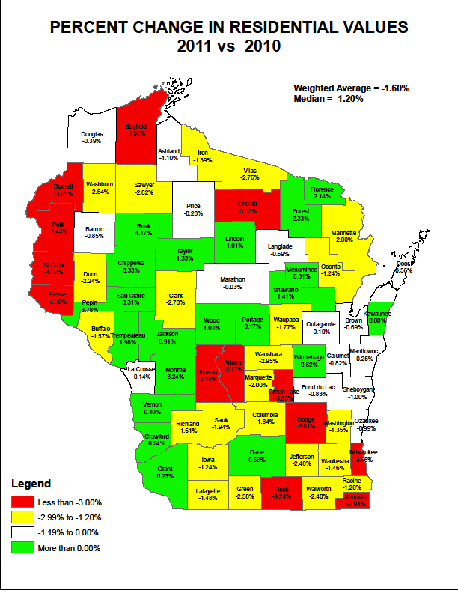

Slide 36
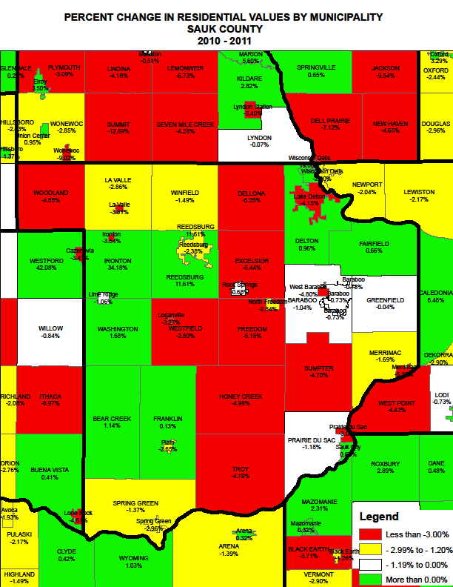

Slide 37
Low Demand for Funds
Households Paying Down Debt

Slide 38
Consumers Still Paying Down Credit Cards
Revolving Credit Has Been Dropping Rapidly Since Feb 2009
Source: Federal Reserve Board of Governors
Last Month Plotted: February 2011
38

Slide 39
Lack of Demand for Funds
Consumers Rapidly De-Leveraging
Consumer Financial Obligations at Lowest Level in 27 years
Source: Federal Reserve Board of Governors
39

Slide 40
On the Other Hand
Federal Borrowing Taking Off

Slide 41
Collateral Damage
Low Interest Rates Reduce Personal Income

Slide 42
Two Sectors Sufficient to Explain the Half-Fast Recovery
Source: BEA, NIPA Table 1.1.2. Contributions to Percent Change in Real Gross Domestic Product

Slide 43
Rest of Economy Outpacing Last Two Recoveries

Slide 44
Wisconsin Outlook in 2012 and 2013

Slide 45
Wisconsin Unemployment Below US Average

Slide 46
Wisconsin Among 25 States with Unemployment Significantly Below US

Slide 47
Milwaukee Manufacturing Edges Up
ISM Manufacturing Index
Notes:
WHAT RESPONDENTS ARE SAYING IN AUGUST:
o On-going inflationary pressure and cost-push has subsided during the month.
o There are consistently fewer cost increase notices as compared to prior months.
o Biggest issue continues to be material price (increases). Steel prices have softened over the
past several months, but I expect that to reverse and start a gradual climb.
o Supplier deliveries – getting terrible.
o A slow July reduced the backlog, which reduced lead times – a good thing.
o No problems with MRO.

Slide 48
Manufacturing Leading
Wisconsin's Recovery

Slide 49
Wisconsin Per Capita Income Growth in 2011 in the Top Quarter

Slide 50
Wisconsin Ranks 25th in Per Capita Personal Income

Slide 51
Wisconsin Income Held Up Better Than US
51

Slide 52
Wisconsin Per Capita Income Edging Closer to US Average

Slide 53
Economy in Transition
Private Job Growth Steady as Government Becomes More Efficient

Slide 54
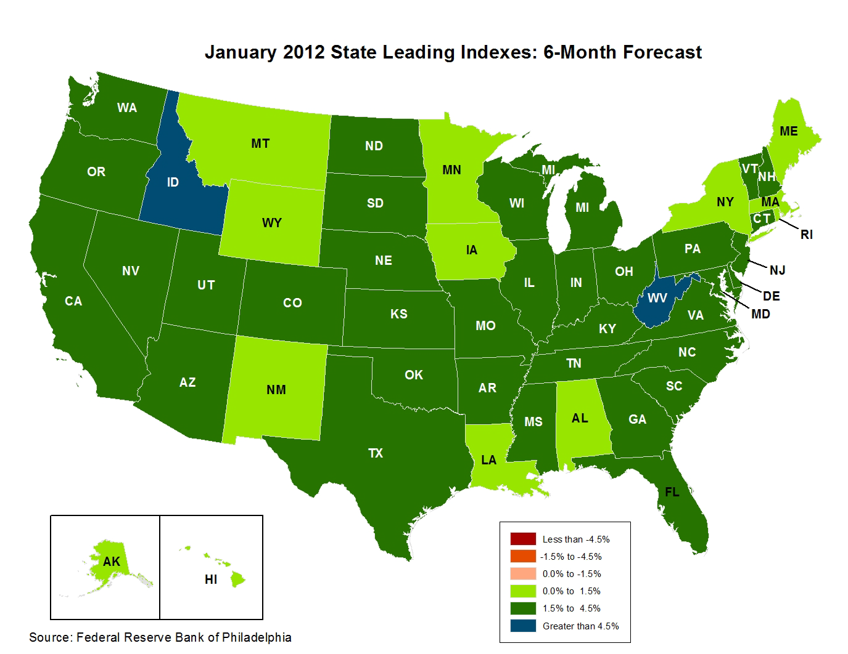
Leading Index Turns Up

Slide 55
Leading Index at Highest Level Since September 2003

Slide 56

Employment Outlook
Wisconsin At US Rate in 2013
Source: Wisconsin DOR, Wisconsin Economic Outlook
http://www.revenue.wi.gov/ra/econ/index.html

Slide 57
Income Outlook
Wisconsin Matches US in 2011 and 2013
Source: Wisconsin DOR, Wisconsin Economic Outlook
http://www.revenue.wi.gov/ra/econ/index.html

Slide 58
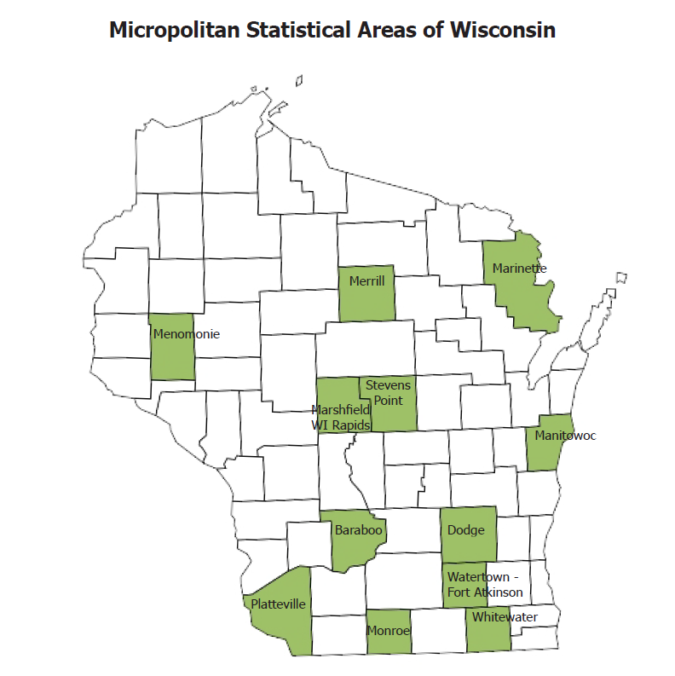

Slide 59
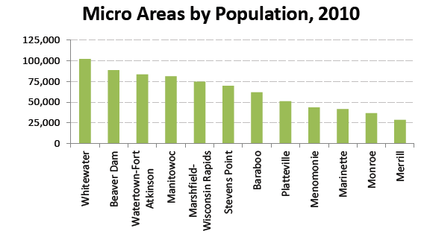

Slide 60
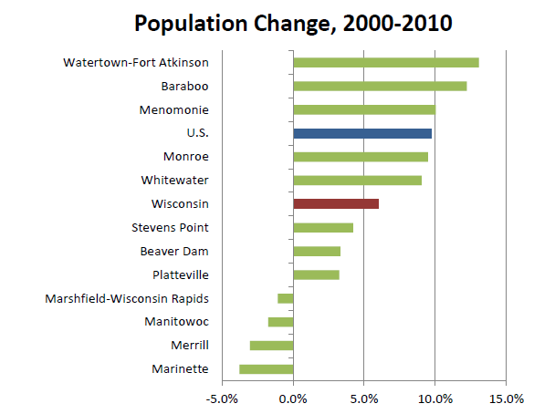

Slide 61
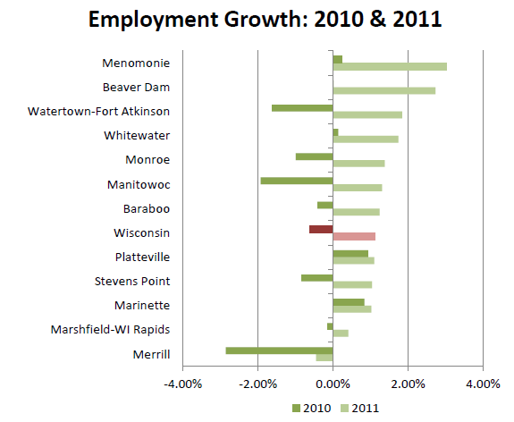

Slide 62
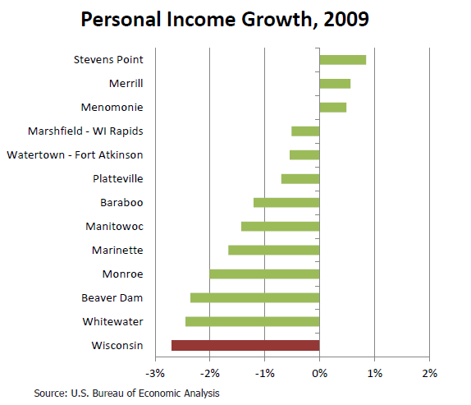

Slide 63
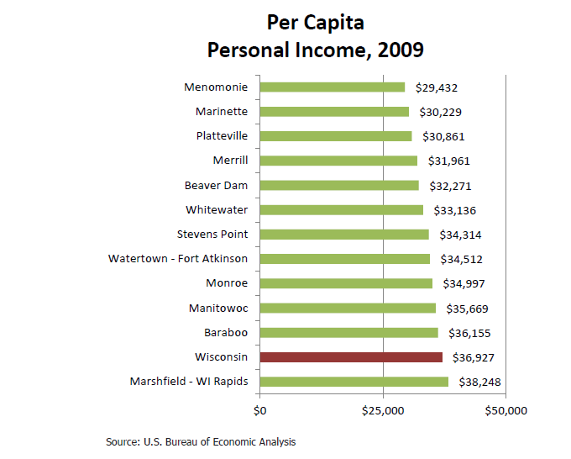

Slide 64
Sauk County Unemployment Near WI Average

Slide 65
Baraboo Micropolitan Area Income Outlook

Slide 66
Baraboo Micropolitan Area Employment Outlook

