Slide 1
WHAT ARE
COUNTIES?
Wisconsin Counties. Helping to make Wisconsin great!
Notes:
Good morning / afternoon.
Introduce yourself as a county official.
Indicate will be describing county government, the services counties provide, and how counties are funded.

Slide 2
WHAT ARE COUNTIES?
A local unit of government
Administrative arm of the state
Service providers
Notes:
Counties are a local unit of government, similar to the local city or town that you live in.
Counties serve as the administrative arm of the state. That means that counties provide a number of services on behalf of state government at the local level.

Slide 3
History of Wisconsin’s Counties
Counties predated statehood
  Performed administrative services for the territorial government
  First three counties were Brown, Crawford, and Michilimackinac (1818)
  By 1901, Wisconsin had 71 counties
  Menominee County became the 72nd county in 1961
Notes:
Several county governments were formed in Wisconsin prior to statehood in 1848.
Counties performed administrative services for the territorial government.
The first three Wisconsin counties were created in 1818: Brown (east), Crawford (west), and Michilimackinac (north – included the U.P.).
As Wisconsin’s population increased, the number of counties in Wisconsin grew. By 1901, Wisconsin had 71 counties.
Our last county was created in 1961 when the reservation of the Menominee Indians of Wisconsin, located in Oconto and Shawano Counties, became Wisconsin’s 72nd county: Menominee.

Slide 4
Notes:
This map shows the configuration of the state’s 72 counties today.
Each of the 72 counties is unique in terms of structure and the services provided; however, many similarities exist as well.

Slide 5
Type of County Government
New York Constitution (supervisor) v. Pennsylvania Constitution (commissioner)
Supervisory form of government prevailed in Wisconsin
  County boards of supervisors
Notes:
Prior to 1870, two forms of county government existed in Wisconsin.
The New York model called for the supervisor form of government where “supervisors” represented towns and incorporated places. Also as part of this system, the county provided state administrative services, while towns and municipalities served as the provider of local government services.
The Pennsylvania model called for the commissioner form of government where a small board of “commissioners” is elected from precincts to represent the interests of the county-at-large.
The supervisory form of government prevailed in Wisconsin after the framers of the state constitution called for a uniform system of town and county government.

Slide 6
Governance
County board of supervisors
  Serve two-year terms
  Elected in even-numbered years
County board chair
Oversight committees
    e.g., county highway committee, emergency management, local board of health, land conservation committee, social/human services board
Board and committee meetings are open to the public
Notes:
Today, each county is governed by a board of supervisors. Board supervisors are elected in the spring, non-partisan elections that are held in even-numbered years.
Board members serve two-year terms.
County board members elect a county board chair whose job it is to run county board meetings, appoint committee members, and serve as a spokesperson for the board.
County boards adopt laws, known as ordinances, for the county. County boards also adopt resolutions that state the position of the county on issues, such as proposed state legislation.
The county board chair appoints committees to study policy issues and make recommendations to the full county board of supervisors. State statutes require the creation of certain committees, such as a county highway committee or local board of health. Counties create other committees as well, such as a personnel committee or finance committee.
County board meetings, as well as committee meetings, are open to the public.

Slide 7
Governance
Each county must have a county executive (11), administrator (23), or administrative coordinator
  County executives are elected
  Administrators and administrative coordinators are appointed by the county board
  Each has different powers and authorities
Notes:
In addition to the county board of supervisors, each county must elect a county executive, or appoint an administrator or administrative coordinator.
County executives act as the executive branch of county government and have the authority to veto actions of the legislative branch – the county board.
County administrators and administrative coordinators carry out the day to day operations of the county and implement the policies set by the county board. An administrator’s duties are set by state law, while many of the administrative coordinator’s duties are determined by the county board.

Slide 8
A Note About Home Rule
Administrative Home Rule
Constitutional Home Rule
  Counties can only undertake a function that is expressly allowed for or mandated by state statute or the constitution.
Notes:
Although counties are a local governmental unit, the state restricts the actions county boards can take and the services counties provide.
Counties have administrative home rule which provides counties flexibility in their organizational structures i.e. how county departments are structured.
Counties do not have constitutional home rule authority – that means that counties can only undertake a function that is expressly allowed for or mandated by state statute or the constitution. That is in contrast to cities and villages that can undertake any function or service as long as that function or service is not expressly prohibited by state statute or the constitution.

Slide 9
Services
Snow Plowing and Road Maintenance
Jail and Law Enforcement
Court Administration
Public Health
Human Services
Libraries
Vital Records
Land Conservation
Property Tax Collection
Elections
Notes:
Counties provide a number of services to the citizens of the state:
Plow snow and maintain state highways and county roads.
Operate the jail and provide law enforcement services through the sheriff’s office.
Protect vulnerable adults and children and administer state and federal assistance programs through the human services department.
Issue birth and death certificates and record property transfers through the register of deeds office.
Issue marriage licenses and domestic partnerships and oversee elections through the county clerk’s office.
Operate and support the circuit courts through the clerk of circuit court’s office.
Monitor sanitary conditions and protect public health through the county health department.
Collect property taxes and other fees through the county treasurer’s office.
Maintain and operate county parks.
Operate 911 emergency dispatch centers.
Help farmer’s conservation efforts and work to keep our rivers and lakes clean.
Some counties also operate airports, ports, museums, and zoos, as well as providing other optional services.

Slide 10
County Expenditures (2012)
Notes:
In 2012, counties, in the aggregate, spent the largest percentage (36%) of their funding on health and human services programs. This includes providing state-mandated services to children in the child welfare system, helping individuals with mental health needs, serving the state’s elderly population, and performing eligibility determinations for individuals in need of public assistance programs.
The next largest category of expenditures was public safety, followed by general government and public works.

Slide 11
County Revenues (2012)
Notes:
In order to pay for services provided, counties receive revenue from a number of sources.
35% of a county’s funding comes from the property tax.
24% comes from the state.
15% is derived from fees.
7% comes from other taxes such as the county sales tax.
And 3% comes from the federal government.

Slide 12
Statewide Percentage of Property Tax Bill – 2013(14)
Notes:
Many people do not realize what a bargain county services are. Counties make up less than 20% of your overall property tax bill.
Less than 20 cents of every dollar you pay in property taxes goes to fund the county services that make Wisconsin such a wonderful place to live, work, and raise a family.

Slide 13
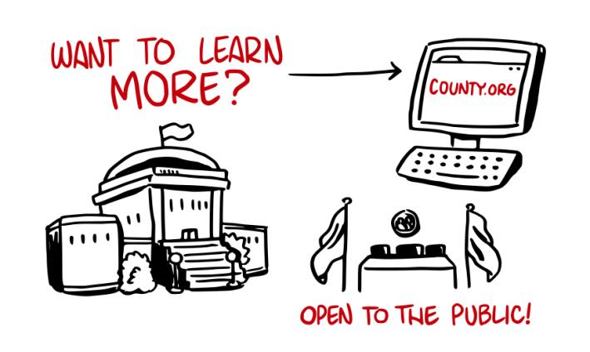
Notes:
Are you interested in learning more about county government?
To find out who your county elected officials are, you can visit your county’s website.
You can also visit www.wicounties.org to find educational materials about county government, as well as a link to each county’s website.

Slide 14
Notes:
Thank you.
Offer to take questions.

