Slide 1
Payment disbursement solution for courts and justice systems

Slide 2
We are the leading provider of
frictionless fintech, payment and engagement solutions
for corporations, state and county governments, municipalities and non-profits
Notes:
About Rapid Financial Solutions
Rapid Financial Solutions is the leading provider of frictionless fintech, payment and engagement solutions for corporations, state and county governments, municipalities, schools, and sports associations.
Our Platform-as-a-Service (PaaS) empowers your organization with a complete suite of fintech, payment and engagement solutions, giving consumers greater choice and connection to the services they need.
Smart connected, commerce
With our smart, connected commerce solutions, organizations can increase operational efficiency. By moving away from cash and paper checks, our more than 1,500 clients have slashed disbursement costs, reduced check fraud, and deepened customer satisfaction and engagement.
Founded in 2005, Rapid Financial Solutions is headquartered in North Logan, Utah, with offices throughout the United States. We own and operate six product brands: CourtFunds, Currencie™, MintCheetah™, rapidENGAGE™, ReleasePay, and RodeoPay. For more information, visit rpdfin.com.

Slide 3
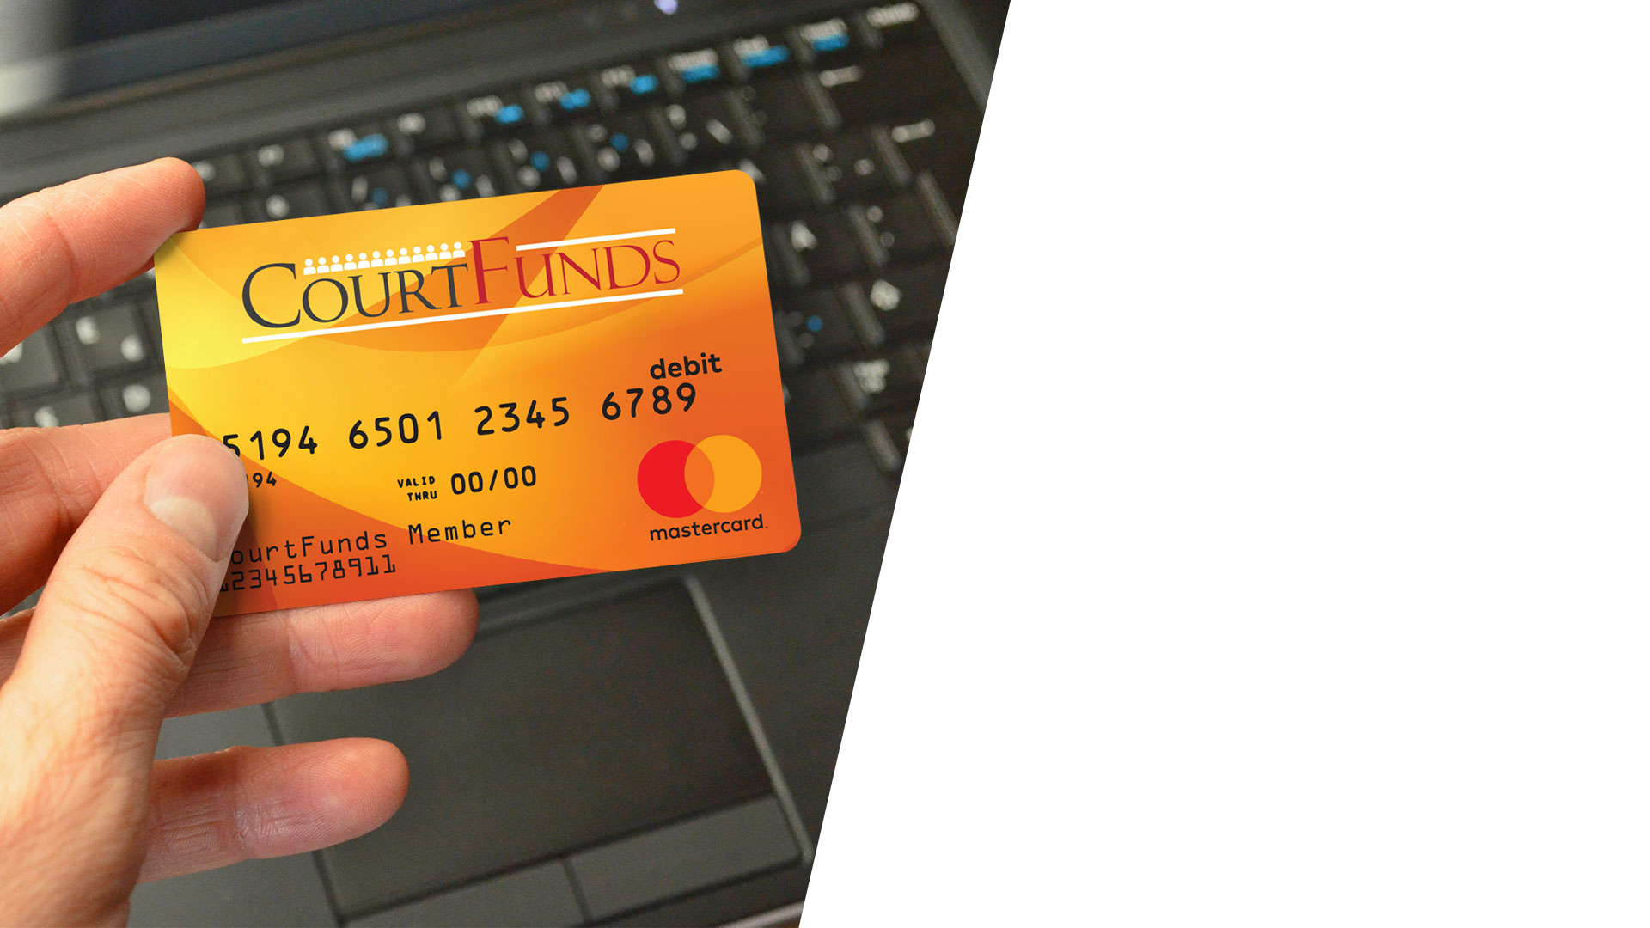
Counties Using CourtFunds
Dane County (Jury and Witnesses)
Wood County (Jury)
Counties Using ReleasePay
32 Counties including:
Dane County
Marathon County
Etc.

Slide 4
Sauk County, WI
Your Process
Connected to CCAP System
Check the jurors in
This checks them in
Get orientation and called to a case
Designated time and day each week to work on payroll
Database of everyone that served (whether regular or reserve)
Double checks to see anything that looks off
Frustrations
Challenge the status quo
Long process
Some departments just double-checking work
How We Can Help
How fast we can help disburse funds
The cost of a check
Unclaimed funds

Slide 5
Juror payments
Child support
Restitution
Bond reimbursements
Witness fees
Poll workers
Notes:
From municipal and county, to state and federal courts, CourtFunds is the contactless way to disburse payments to everyone accurately and on time, no matter what part of the transaction they play a part in — jury payments, restitution, child support, bonds, witnesses, and more.
With CourtFunds you can:
Curtail unclaimed property and escheatment incidents
Eliminate lost or stolen checks
Reduce check fraud risk
Reduce bank account reconciliation time
Provide instant access to funds for constituents
Increase efficiency through contactless technology
Reduce cash handling on site
Slash disbursement costs
Reduce disbursement customer service issues
Integrate directly with CMS, JMS, accounting and financial systems

Slide 6
Challenge:
check management costs
Paper checks vs. electronic payments: the differences are clear
 | Paper Checks $7.78 per check | Electronic Payments Nominal fee
Daily | $130.00 | $8.16
Monthly | $3,890.00 | $245.00
Annual | $46,680.00 | $2,940.00
Savings |  | 176.3%
7
.
$
7
8
The average
cost to issue
a paper check
Source: Aberdeen Group
Notes:
Rapid’s disbursement solutions eliminate checks completely and all costs associated with managing them.
Paper check costs include more than just postage…
Supplies:
Check paper
Envelopes and stamps
Check details report or stub
Printer ink – some of this ink can be very costly (MICR ink)
Check printer
Manpower and services:
Sorting, stuffing, sealing, and transportation
Approval and signing of checks – some companies require two signatures per check
Bank reconciliation
Follow up, reports, and audits
Monthly maintenance fee
Daily transmission and bouncer sheet fee
Risk and treasury management charges per check
Stop payment fee per check

Slide 7
Challenge:
unclaimed property
Our digital money platform helps you reduce the number of escheatment incidents that can drain your team’s time monthly and annually.
$3B+
The amount of unclaimed property returned by states annually, according to the National Association of Unclaimed Property Administrators
Notes:
Our solutions handle all unclaimed property and escheatment according to state statutes and regulations.
Rapid Financial Solutions is here to help you reduce the number of escheatment incidents that can drain your team’s time monthly and annually. Our digital money platform helps businesses, counties, municipalities, associations, and non-profits make pay disbursements with ease, and eliminates the headaches that come with unclaimed property.

Slide 8
Challenge:
lost and stolen checks
Lost and stolen checks lead to many accounting and administrative hassles.
Unclaimed property and escheatment
Bank account reconciliation headaches
Customer service issues
Lost productivity
Check fraud risk
Notes:
If you don’t issue paper checks, there aren’t any to be lost or stolen.
Lost and stolen checks lead to many number of issues, including:
Unclaimed property and escheatment
Bank account reconciliation headaches
Customer services issues ( and lost productivity)
Check fraud risk

Slide 9
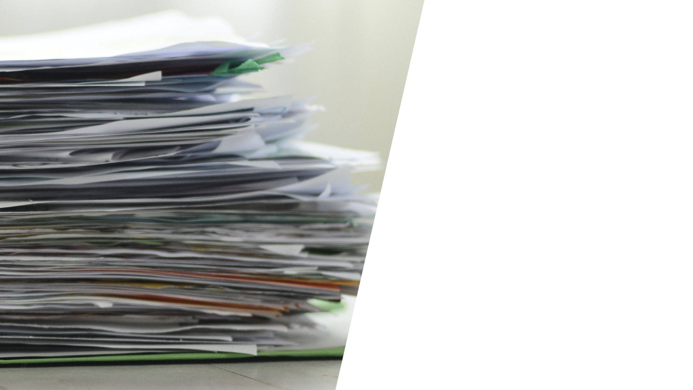
Challenge:
the stack of
returned checks
Time consuming
Inefficient
Not a good use of taxpayer money
Bad for team morale
Notes:
Wouldn’t it be nice to be rid of this headache? Get your sanity back.
Jury payments - As you know, one of the leading culprits for returned checks to courts is jury payments. And when it happens, they become part of the pile that your finance team has to deal with — calling the juror, tracking down a forwarding address, reprinting, remailing.
Child support payments –
The issue of address changes. If the parent receiving child support checks moves and neglects to provide a forwarding address to the court, the check will be returned. Following this, a member of your accounting and finance team must hunt down the payment receiver’s proper address and re-mail the check. It goes without saying that this is a very inefficient and frustrating process for everyone involved.
Receiving parent may not want to share their new address for safety concerns. All too frequently, this means the child support check may sit in the mailbox at the old address or be thrown away by the new tenant. But quite often, the check finds its way back to the court. When this happens, it’s up to your finance team to cancel the check and re-mail the payment to the receiver’s correct address.
This kind of tedious goose-chasing takes a toll on your finance team can hurt productivity. Even worse? Those in need of on-time child support checks suffer from late payments.
Restitution - The timely and accurate delivery of court-ordered restitution payments is vitally important to the fabric of a community. Community members, families, and victims owed restitution deserve to have payments delivered on time.
Exit payments for inmates – Unfortunately, it can be tough to track down the current address for someone after they’ve left your facility. When that happens, it’s a huge productivity killer for your finance team - hunt down the payment receiver’s proper address and re-mail the check. It goes without saying that this is a very inefficient and frustrating process for everyone involved.

Slide 10
Challenge:
check fraud
Businesses making payments with paper checks are more susceptible to fraud.
500 million
$10 billion
The number of checks that are forged each year.
Total annual check fraud
losses.
74%
organizations that
have experienced
check fraud
$5.9 billion
$789 million
Fraudulent checks
intercepted by banks in 2016. And yet…
Despite banks intercepting fraudulent checks, $789M of fraud was committed.
Sources:
PwC Global Economic Crime and Fraud Survey 2020, https://www.pwc.com/gx/en/forensics/gecs-2020/pdf/global-economic-crime-and-fraud-survey-2020.pdf
SQN Banking Systems, 101 Facts About Check Fraud, https://sqnbankingsystems.com/resources/articles/101-facts-about-check-fraud/
Association for Finance Professionals, 2020 AFP Payments Fraud and Control Survey, https://dynamic.afponline.org/paymentsfraud/p/1
Notes:
With our solutions, there are no more checks.

Slide 11
More people touching a single object results in
more germs transmitted
Traditional disbursements
Touchless disbursements
DONE!
Check is printed
Check signed by 1-2 people
Check stuffed into envelope
Check is mailed
Disbursement
file uploaded
Recipient paid immediately
YUCK!
Check picked up by USPS
Mailroom and container
handling
Check delivered
Recipient receives check

Slide 14
Justin Miller
Justin.miller@rpdfin.com 435-232-1835

